Slide 1
Maine Department of Labor Bureau of Labor Standards Workplace Safety & Health Division-SafetyWorks! Steve Greeley, Director

Slide 2
Objectives
Cooperative Programs
VPP
SHARP
SHAPE
Trivia Question

Slide 3
Background
OSHA created by OSH Act 1970
Enforcement Private Sector/Federal Govt.
State Plan States (Maine) August 5, 2015
Consultation Programs
Compliance Assistance
Cooperative Programs

Slide 4
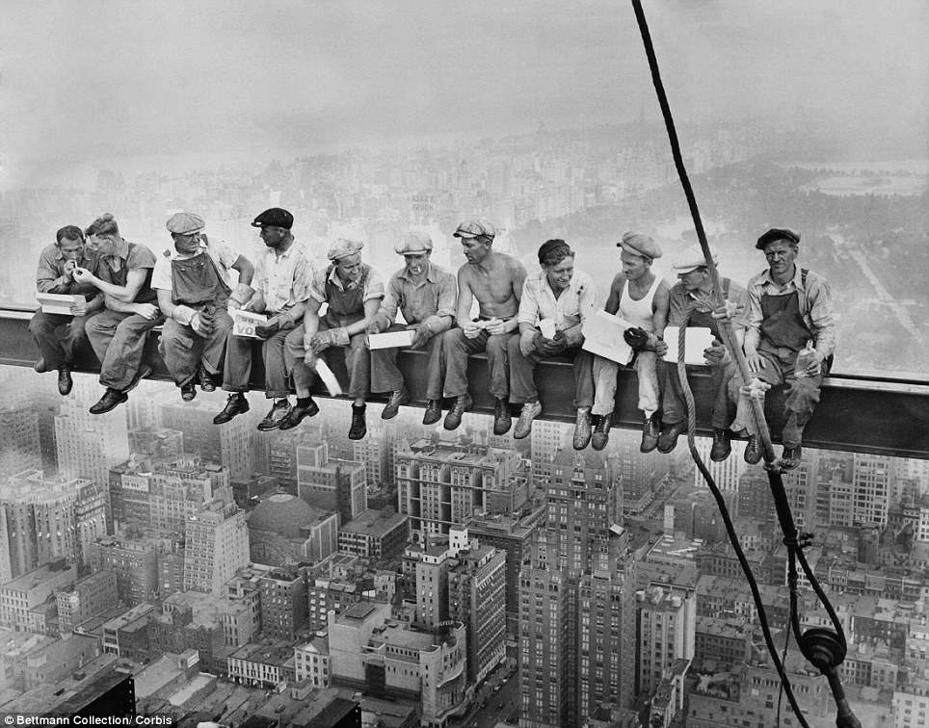
The Before Picture!

Slide 5
The After Picture!
VPP (12)
SHARP (62)
Designed for larger employers-No size restrictions
Compliance Assistance Specialists (OSHA)
Special Government Employees
VPPPA
OSHA exemption
Designed for smaller employers with less than 250/500
21(d) Consultation Safety & Health Specialists (State)
Form 33
MESHE
OSHA exemption

Slide 6
Safety & Health Award for Public Employers
SHAPE (65):
Inception 2005
Available for all/part of towns, agencies, campuses, etc.
38 Fire Service
10 Cities/Towns *
4 Technical High Schools
DOT-3 Regions including Fleet Services
3 College Facilities (2 farms/1 campus)
1 County
2 Hospitals
BLS

Slide 7
SHAPE
No size restrictions
Safety & Health initial review
Injury data analysis
Follow-up review
Participate with MESHE
W/C reduction
BLS enforcement exemption

Slide 8
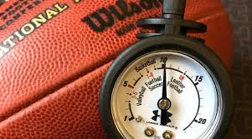
Trivia/Closing Comments
All the Commissioners in this room please raise your hand.
Scarborough’s most infamous summer resident is also a Commissioner?
Questions

